Slide 1
Foundations of Group Behavior 1

Slide 2
Group
Two or more individuals, interacting and interdependent, who have come together to achieve particular objectives.
Formal groups
By organization
Informal groups
Need for social contact

Slide 3
Group
Social Identity Theory
Individual’s self-concept is derived from perceived membership in a relevant social group
Formation of the concept of “we-ness”

Slide 4

Group
Social Identity Theory
Ingroup vs. outgroup
Ingroup favoritism

Slide 5
Group
When do people develop a social identity?

Slide 6
Group
How to promote

Slide 7
Stages of Group Development
The Five-Stage Model

Slide 8
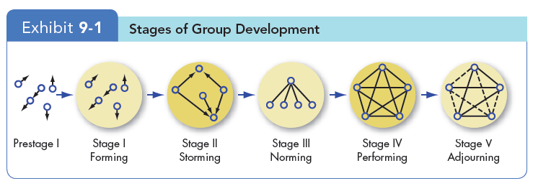
Stages of Group Development
Forming: chaos
Storming: conflict
Norming: stable
Performing: functional (final stage for continuous)
Adjourning: break up

Slide 9
Stages of Group Development
Different pace
Performing stage more rapidly
Simultaneous stages
Backward

Slide 10
Alternative Model for Temporary Groups with Deadline
Punctuated Equilibrium Model
A set of phases that temporary groups go through that involves transitions between inertia and activity

Slide 11
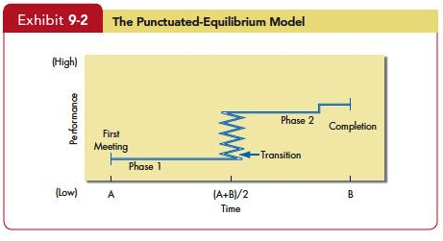
Alternative Model for Temporary Groups with Deadline

